Slide 1
Security Architecture & Design Review with Threat Modeling
By Dabire Christ-Fortune
Cyber Security Engineer

Slide 3
Security architecture & Design review
Security architecture and design review is the process of evaluating and improving the security of a system, application, or network by considering its design, implementation, and deployment. The goal is to ensure that the system is secure and resilient against potential security threats and vulnerabilities, and that it meets the security requirements and standards of the organization.
The security architecture review typically includes:
A review of the design specifications and architecture diagrams
Threat modeling to identify potential security threats and vulnerabilities
Evaluation of security controls and countermeasures included in the design
Identification of potential design weaknesses
Documentation of review findings and recommendations for improvement
The goal of enhancing overall security of the system.
The security review is an important step in the software development life cycle (SDLC) and should be conducted regularly to ensure that the system remains secure over time and adapts to changes in the threat landscape. The review process should be integrated into the SDLC and be performed by a team of security experts who have the necessary knowledge and skills to evaluate the system from a security perspective.

Slide 4
Security architecture and design review
A typical security architecture and design review process includes the following steps:
Planning and Preparation: This includes defining the scope and objectives of the review, identifying the review team, and establishing the timeline for the review. It also includes obtaining all relevant documentation, such as design specifications, architecture diagrams, and any existing threat models, and preparing the review checklist.
Threat modeling: This involves identifying potential security threats and vulnerabilities that the system may face, and documenting them in a threat model.
Architecture Implementation review: This involves reviewing the implementation of the security controls and countermeasures to ensure that they are properly implemented and meet the security requirements and standards of the organization.
Deployment review: This involves reviewing the deployment of the system to ensure that it is secure and that the security controls and countermeasures are properly configured.
Reporting and recommendations: This involves documenting the findings of the review, including any potential security threats and vulnerabilities, and making recommendations for improvement.
Follow-up: This involves implementing the recommendations made during the review, conducting regular follow-up reviews, and updating the design as necessary to ensure the security of the system.

Slide 5




EXAMPLE OF SECURITY ARCHITECTURE & DESIGN REVIEW FOR AN ECOMMERCE WEB APPLICATION
Security Team obtains all the relevant architecture design documents and asks Ecommerce Web application development team for a architecture walkthrough
Security Team starts preparing a Secure Design Review checklist and also performs the Threat Modeling exercise as per the inputs received
Security Team provides a walkthrough of Threat Modeling report and a review of security findings/recommendations is performed with the Ecommerce Web application development team
Final Security Architecture Review report is generated and security control implementation is reviewed on regular basis

Slide 6
Security Architecture & Design Review with Threat Modeling
Threat Modeling Basics, Tools and Techniques

Slide 7
Threat modeling & its tools
Threat modeling is a structured process for identifying, analyzing, and prioritizing potential threats to a system or application and determining ways to mitigate those threats. It helps organizations to understand the assets they need to protect and the risks they face so that they can allocate resources and implement countermeasures effectively.
Goal of Threat Modeling: To identify potential security weaknesses before they can be exploited by attackers, and to prioritize the mitigation of the most critical threats first.
Tools for Threat Modeling:
Microsoft Threat Modeling Tool (Free tool from Microsoft but its Manual Process that starts with creating DFDs)
IriusRisk (SaaS Threat Modeling Tool)
ThreatSpec (Open Source Project)
ThreatModeler (Automated Threat Modeling Tool works well with many cloud providers like AWS etc.)

Slide 8
Threat modeling techniques
Threat Model | Purpose | Key Characteristics | Advantages
STRIDE | Categorize threats based on type of attack | Spoofing, Tampering, Repudiation, Information disclosure, Denial of Service, Elevation of Privilege | Simple and straightforward approach for categorizing threats
PASTA | Consider the entire software development life cycle and entire application architecture | Process for Attack Simulation and Threat Analysis | Considers the complete software development life cycle and application architecture
DREAD | Prioritize security threats based on level of risks | Damage, Reproducibility, Exploitability. of risk Affected Users, Discoverability | Provides a simple and effective way to prioritize security risks

Slide 9
Some other Threat Modeling Techniques are:
LINDDUN
TFTP
Architecture-Centric
Data-Centric
Note: We will focus only on most widely used techniques i.e. STRIDE Threat Modeling

Slide 10
How security architecture review is related with threat modeling
Security Architecture Review
Gather requirements, architecture diagrams and walkthroughs
2. Prepare Design Review checklist and perform Threat Modeling
3. Walkthrough of Threat Modeling report
4. Final Security Architecture Review report
Threat Modeling
Perform Threat Modeling
2. Walkthrough of Threat Modeling Report with recommendations

Slide 11
Security Architecture & Design Review with Threat Modeling
Let's learn most popular Threat Models-
STRIDE and DREAD

Slide 12
Stride basics
STRIDE is a threat modeling framework that helps security professionals identify potential threats to software systems. The acronym stands for the six different types of threats that a system may face: Spoofing, Tampering, Repudiation, Information Disclosure, Denial of Service, and Elevation of Privilege. Let's understand these in detail.
Spoofing: Spoofing is when an attacker impersonates a legitimate user or entity in order to gain unauthorized access to a system. For example, an attacker might use a fake email address or website to trick a user into providing sensitive information.
Tampering: Tampering is when an attacker modifies data or code in a system in order to gain unauthorized access or cause damage. For example, an attacker might modify a password file to gain access to a system, or modify an application's code to introduce vulnerabilities.
Repudiation: Repudiation is when an attacker denies having performed an action, in order to avoid accountability. For example, an attacker might delete log files to cover up their tracks, or deny having sent an email that contains sensitive information.
Information Disclosure: Information disclosure is when an attacker gains access to sensitive information that they should not be able to access. For example, an attacker might eavesdrop on network traffic to intercept sensitive data, or gain access to a user's personal information through a vulnerability in an application.

Slide 13
Denial of Service: Denial of Service (DoS) is when an attacker prevents legitimate users from accessing a system or application by overwhelming it with traffic or by exploiting vulnerabilities. For example, an attacker might launch a Distributed Denial of Service (DDoS) attack to overload a server with traffic and make it unavailable to users.
Elevation of Privilege: Elevation of Privilege is when an attacker gains higher-level access to a system or application than they are authorized to have. For example, an attacker might exploit a vulnerability in an application to gain administrative access to a system.
By analyzing each of these threat categories in the context of a specific system or application, security professionals can identify potential vulnerabilities and develop strategies to mitigate those risks. STRIDE is a useful tool for threat modeling because it provides a systematic and structured approach to identifying potential security risks, which can help organizations develop more effective security strategies.

Slide 14
Dread basics
The DREAD model is a framework for evaluating and prioritizing security risks associated with software systems. The acronym stands for Damage potential, Reproducibility, Exploitability, Affected users, and Discoverability.
Damage potential: This refers to the extent of damage that can be caused if a vulnerability is exploited. This could include financial losses, reputation damage, or legal consequences.
Reproducibility: This refers to how easily an attacker can reproduce the vulnerability. A vulnerability that can be easily reproduced by an attacker is considered more severe than one that is difficult to reproduce.
Exploitability: This refers to the level of expertise required to exploit the vulnerability. A vulnerability that can be easily exploited by a novice attacker is considered more severe than one that requires advanced skills.
Affected users: This refers to the number of users who could be affected if the vulnerability is exploited. A vulnerability that affects a large number of users is considered more severe than one that affects only a few users.
Discoverability: This refers to how easy it is for an attacker to discover the vulnerability. A vulnerability that is easy discovered by an attacker is considered more severe than one that is difficult to discover.
The DREAD model uses a scale of 0 to 10 to rate each of these categories, with 10 being the most severe After evaluating each category, the scores are added together to get a total score for the vulnerability. The higher the score, the more severe the vulnerability. The DREAD model is useful for prioritizing security risks because it allows security professionals to focus their efforts on the vulnerabilities that pose the greatest risk to a system.

Slide 15
Security Architecture & Design Review with Threat Modeling
Case Study for Security Architecture & Review exercise

Slide 16
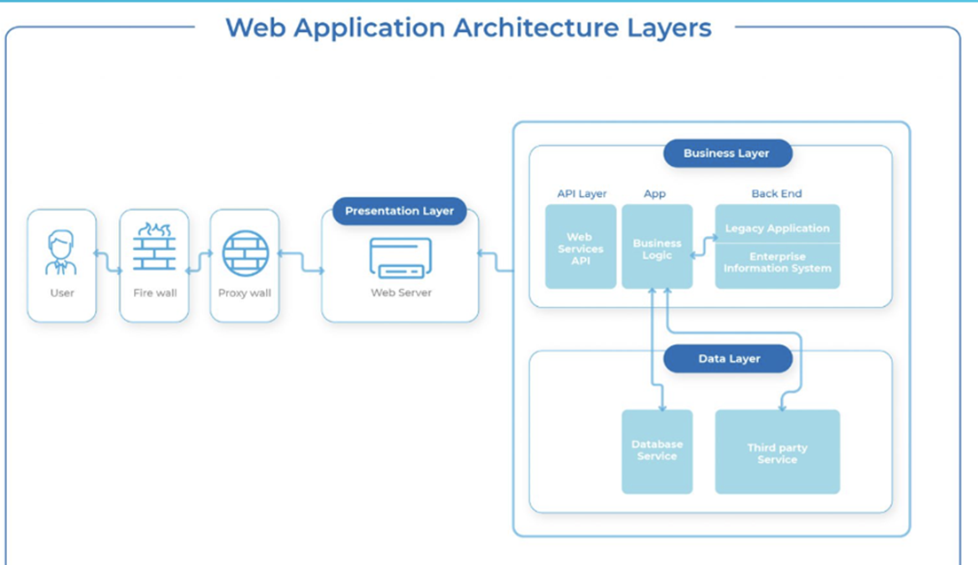
Case study for sr&dr activity
Details of Sample Case Study:
DUMMY Corporation has engaged you to perform Security Architecture and Review of their Ecommerce Application
2. The Web Application is a simple 3 layer Application i.e. Presentation layer, Business Layer (API Layer) and Data Layer
3. The Architecture Diagram on the left have been shared
4. Please perform the Security Architecture and Review Activity.
We have been provided with the architecture diagram on the left.

Slide 17
Inputs given by dummy corporation
Currently, Developers do not have a Secure Training Program
DDOS Protection is not enabled on Firewall
SIEM Program is not in place
User input in only validated at client side
Server logs are backed up on same server
Encryption mechanism being used for data-in-transit is TLS 1.1
MD5 algorithms is used for generating password hashes
Data in database is not encrypted
Database backup schedule is not documented
Firewall alerts are not monitored real time

Slide 18
Steps to perform security architecture & review for this case
Following are the steps in order that you should follow to perform Security Architecture and Review for this project:
Ask DUMMY Corporation to provide a walkthrough of the application in scope and to share any architecture diagrams (if any)
2. Create a Security Architecture and Review Checklist based on the information provided by DUMMY Corporation
3. a) Perform a Threat Modeling Exercise using Microsoft Threat Modeling Tool and create a DFD (Data Flow Diagram). DFD is a way of representing a flow of data through a process or a system.
b) Generate a report from Threat Modeling tool as per STRIDE Model and highlight all the assets and security controls applicable to each asset.
4.Prepare a final Summary report for all the stakeholders.

Slide 19
Security Architecture & Design Review with Threat Modeling
Security Architecture & Design Review Checklist
This Checklist is used to identify missing security controls and identify threats.
These threats will be added in the final SAR Report.

Slide 20
Thanks!!!!!

